Slide 1
Case Study – EV Vehicle Data
Name and USN of the Team member 1: Akash S S , 1BM22AI008
Name and USN of the Team member 2: Bhavan P , 1BM22AI028
Guided by,
Sowmya Lakshmi B.S
Asst. Professor

Slide 2
Details of Case Study
Problem Statement - KPI’S Requirement
Total Vehicles:
Understand the overall landscape of electric vehicles, encompassing both BEVs and PHEVs, to assess the market's size and growth.
2. Average Electric Range:
Determine the average electric range of the electric vehicles in the dataset to gauge the technological advancements and efficiency of the EVs.
3. Total BEV Vehicles and % of Total BEV Vehicles:
Identify and analyze the total number of Battery Electric Vehicles (BEVs) in the dataset.
Calculate the percentage of BEVs relative to the total number of electric vehicles, providing insights into the dominance of fully electric models.
4. Total PHEV Vehicles and % of Total PHEV Vehicles:
Identify and analyze the total number of Plug-in Hybrid Electric Vehicles (PHEVs) in the dataset.
Calculate the percentage of PHEVs relative to the total number of electric vehicles, offering insights into the market share of plug-in hybrid models.

Slide 3
Details of Case Study
Problem Statement - Charts Requirement
Total Vehicles by Model Year (From 2011 Onwards):
Visualization: Line/ Area Chart
Description: This chart will illustrate the distribution of electric vehicles over the years, starting from 2010, providing insights into the growth pattern and adoption trends.
2. Total Vehicles by State:
Visualization: Map Chart
Description: This chart will showcase the geographical distribution of electric vehicles across different states, allowing for the identification of regions with higher adoption rates.
3. Top 10 Total Vehicles by Make:
Visualization: Bar Chart
Description: Highlight the top 10 electric vehicle manufacturers based on the total number of vehicles, providing insights into the market dominance of specific brands.
4. Total Vehicles by CAFV Eligibility:
Visualization: Pie Chart or Donut Chart
Description: Illustrate the proportion of electric vehicles that are eligible for Clean Alternative Fuel Vehicle (CAFV) incentives, aiding in understanding the impact of incentives on vehicle adoption.
5. Top 10 Total Vehicles by Model:
Visualization: Tree map
Description: Highlight the Top N electric vehicle models based on the total number of vehicles, offering insights into consumer preferences and popular models in the market.

Slide 4


Screenshot TABLEAU Registration of each team member
1BM22AI028 - Bhavan P
1BM22AI008 - Akash S S

Slide 5


Screenshot TABLEAU Registration of each team member
1BM22AI028 - Bhavan P
1BM22AI008 - Akash S S

Slide 6

Implementation (Worksheets)
Worksheet 1 - Total Vehicles: Understand the overall landscape of electric vehicles, encompassing both BEVs and PHEVs, to assess the market's size and growth.

Slide 7
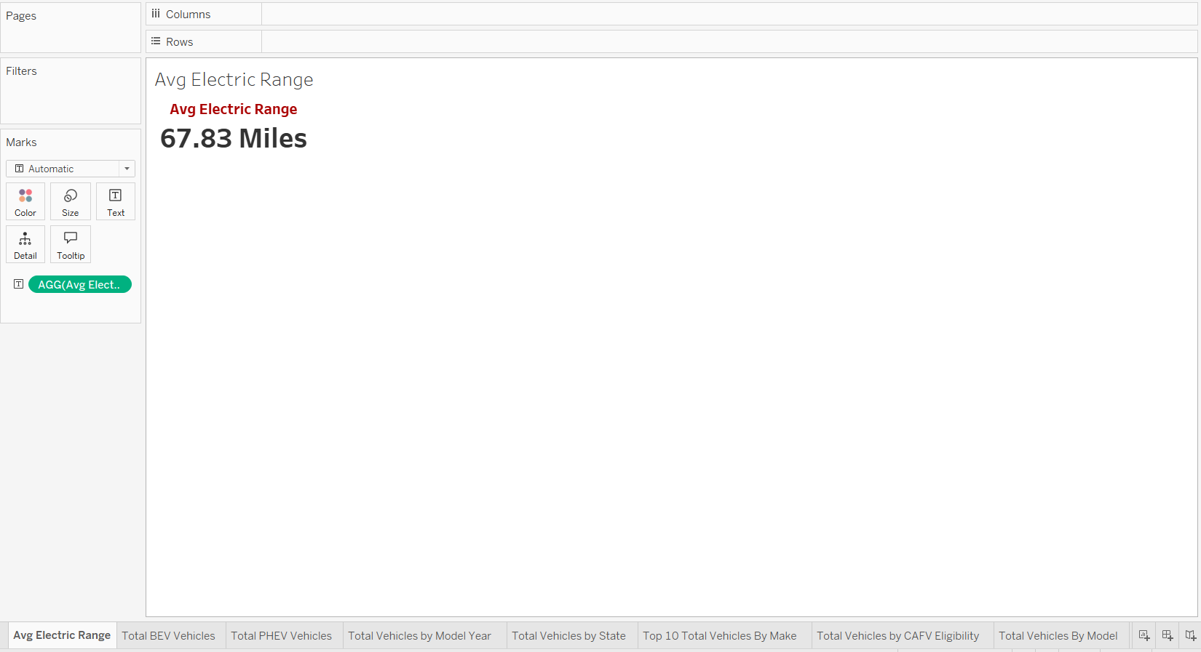
Implementation (Worksheets)
Worksheet 2 - Average Electric Range: Determine the average electric range of the electric vehicles in the dataset to gauge the technological advancements and efficiency of the EVs.

Slide 8

Implementation (Worksheets)
Worksheet 3 - Total BEV Vehicles and % of Total BEV Vehicles: Identify and analyze the total number of Battery Electric Vehicles (BEVs) in the dataset.
Calculate the percentage of BEVs relative to the total number of electric vehicles, providing insights into the dominance of fully electric models.

Slide 9
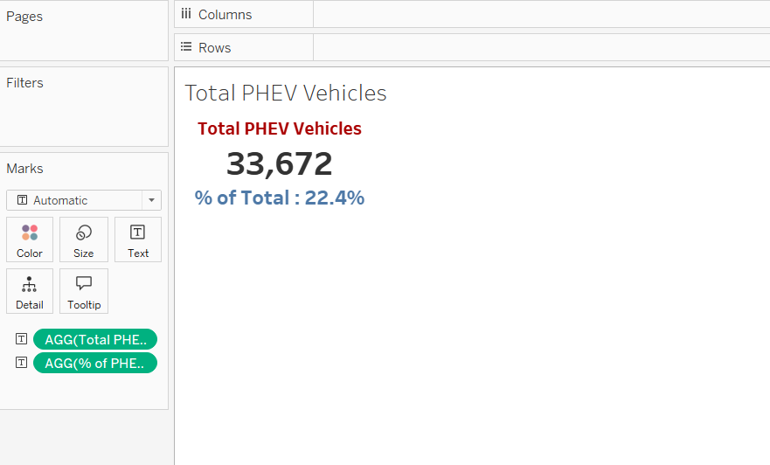
Implementation (Worksheets)
Worksheet 4 - Total PHEV Vehicles and % of Total PHEV Vehicles: Identify and analyze the total number of Plug-in Hybrid Electric Vehicles (PHEVs) in the dataset.
Calculate the percentage of PHEVs relative to the total number of electric vehicles, offering insights into the market share of plug-in hybrid models.

Slide 10
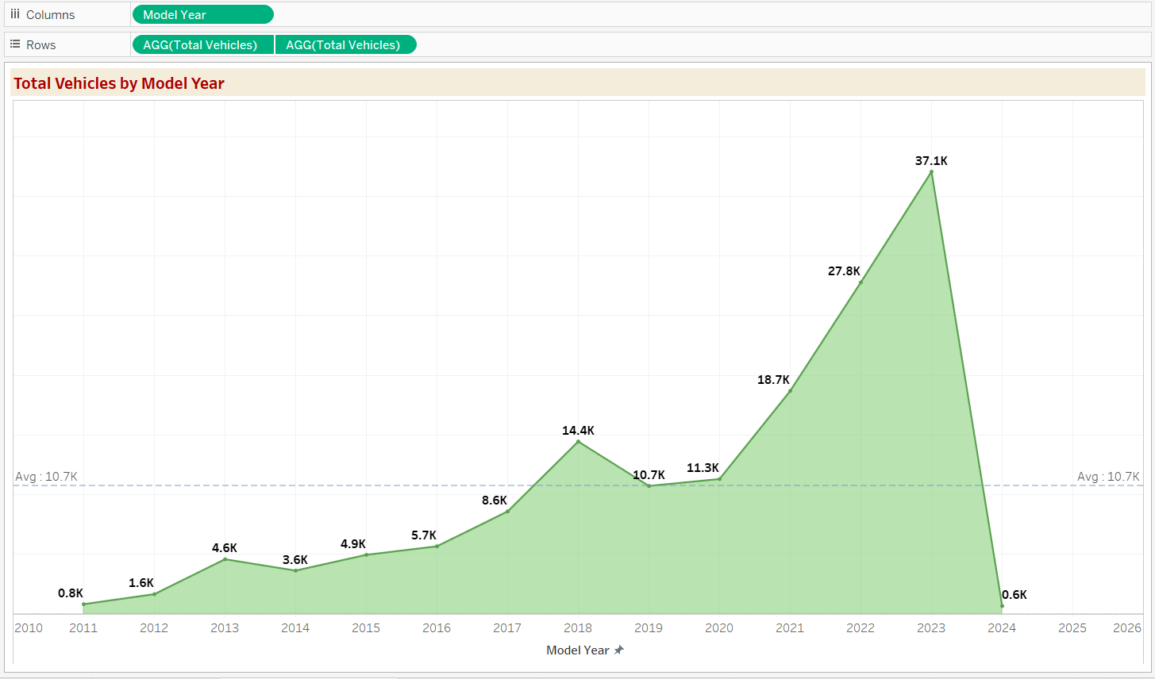
Implementation (Worksheets)
Worksheet 5 - Total Vehicles by Model Year (From 2011 Onwards):
Visualization: Line/Area Chart
Description: This chart will illustrate the distribution of electric vehicles over the years, starting from 2010, providing insights into the growth pattern and adoption trends.

Slide 11
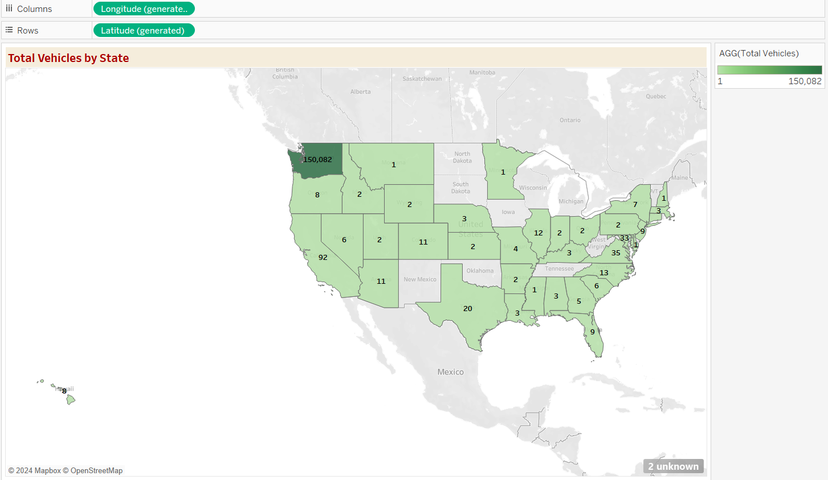
Implementation (Worksheets)
Worksheet 6 - Total Vehicles by State:
Visualization: Map Chart
Description: This chart will showcase the geographical distribution of electric vehicles across different states, allowing for the identification of regions with higher adoption rates.

Slide 12
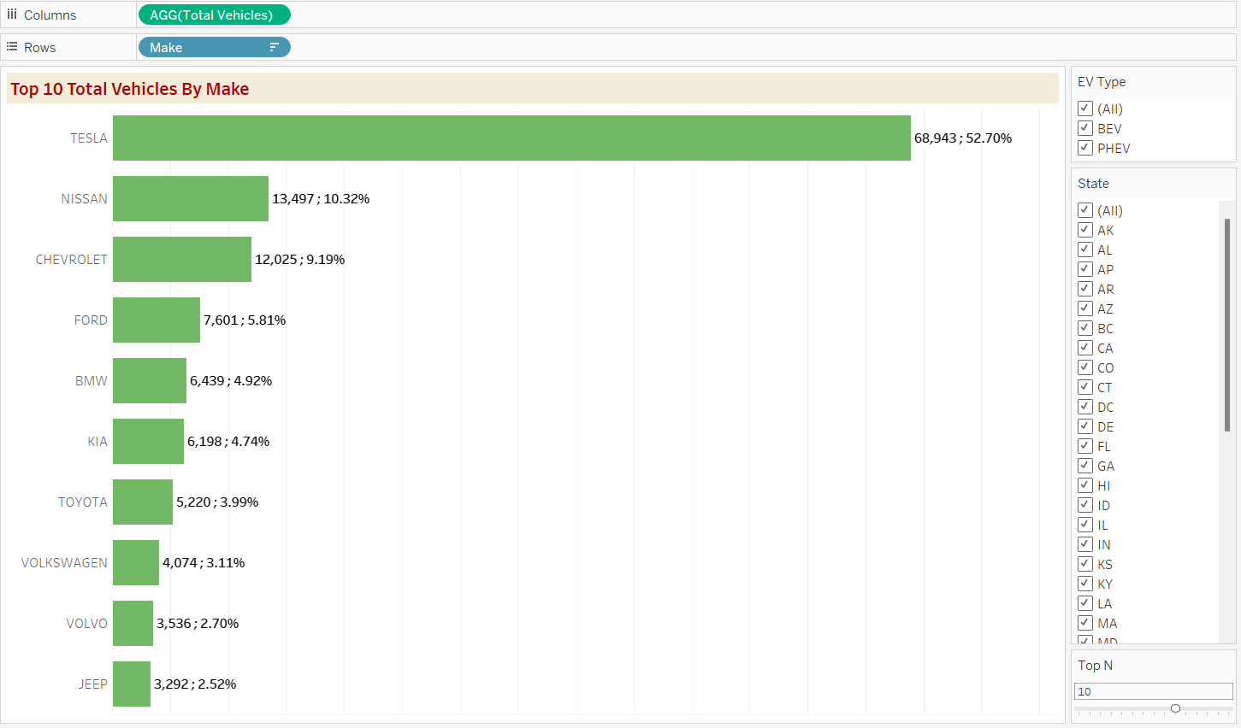
Implementation (Worksheets)
Worksheet 7 - Top 10 Total Vehicles by Make:
Visualization: Bar Chart
Description: Highlight the top 10 electric vehicle manufacturers based on the total number of vehicles, providing insights into the market dominance of specific brands.

Slide 13
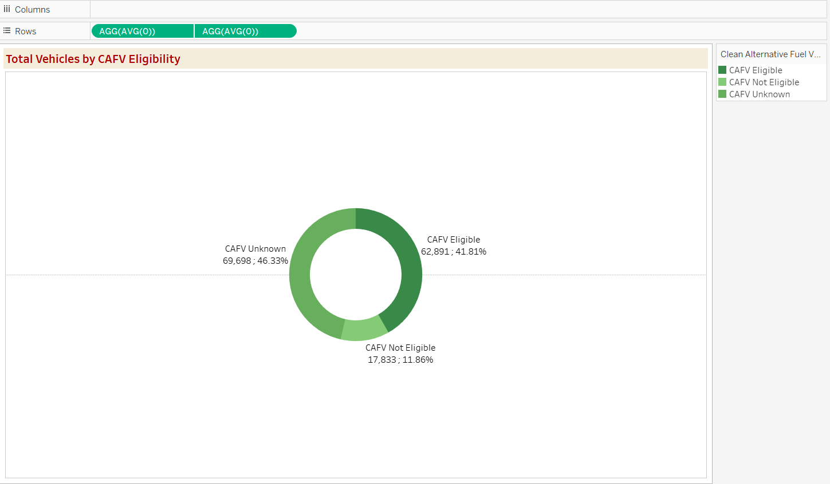
Implementation (Worksheets)
Worksheet 8 -Total Vehicles by CAFV Eligibility:
Visualization: Pie Chart or Donut Chart
Description: Illustrate the proportion of electric vehicles that are eligible for Clean Alternative Fuel Vehicle (CAFV) incentives, aiding in understanding the impact of incentives on vehicle adoption.

Slide 14
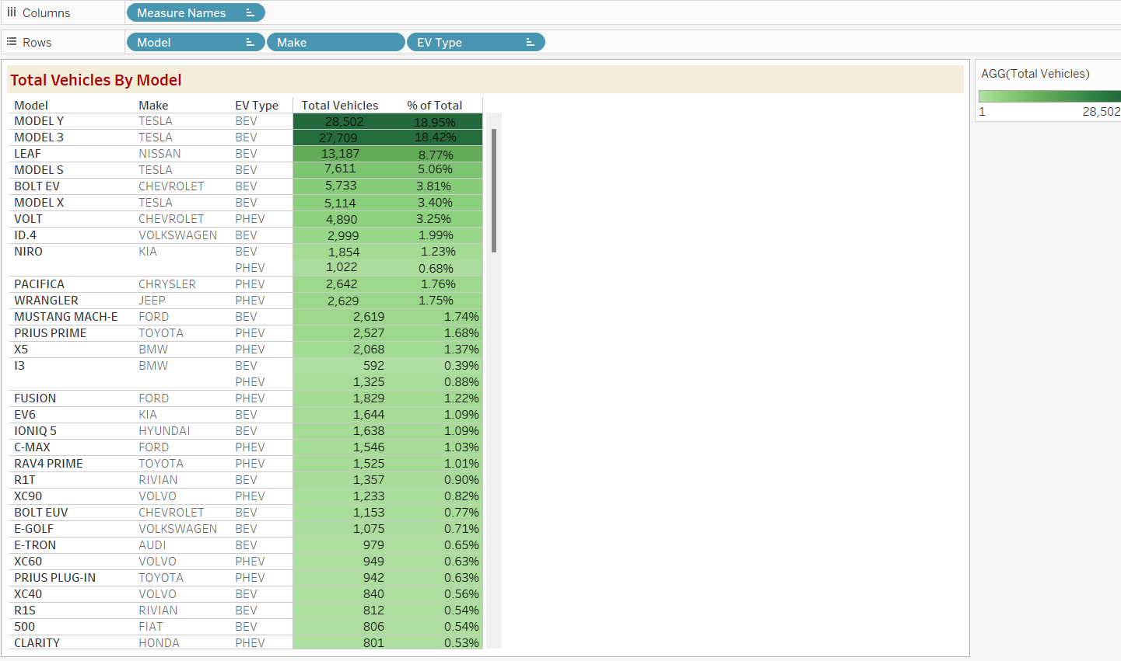
Implementation (Worksheets)
Worksheet 9 - Top N Total Vehicles by Model:
Visualization: Tree map
Description: Highlight the Top N electric vehicle models based on the total number of vehicles, offering insights into consumer preferences and popular models in the market.

Slide 15
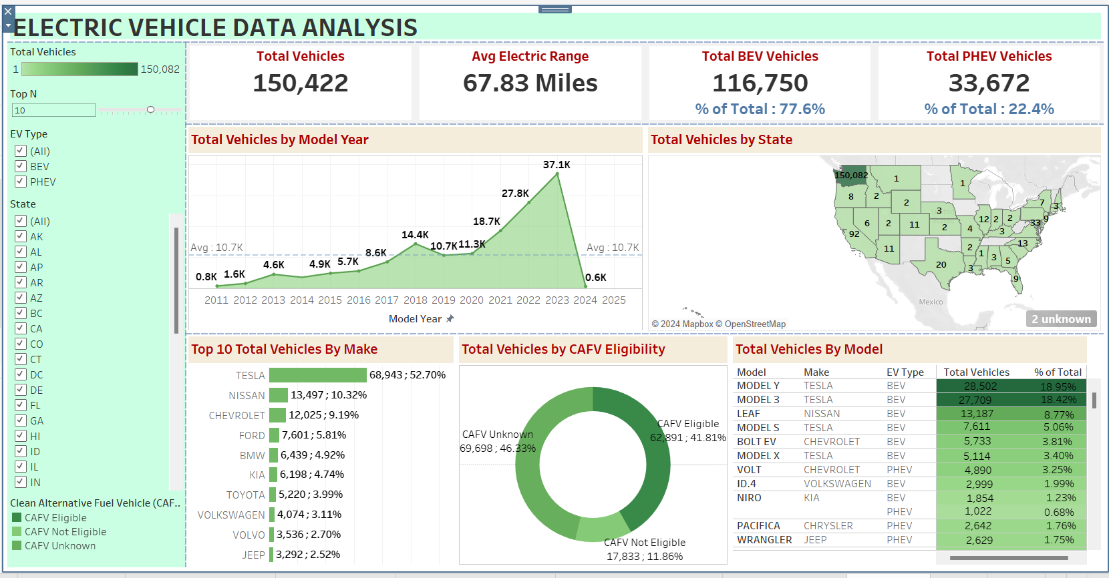
Implementation (Dashboard)

Slide 16
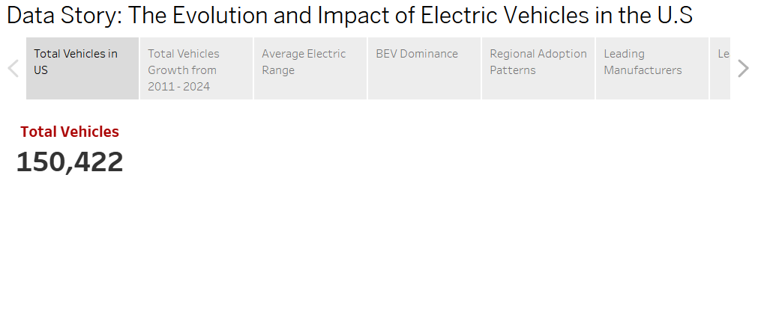
Implementation (Data Story)
Data Story: The Evolution and Impact of Electric Vehicles in the U.S
Data Story 1 - Total Vehicles in US: The journey of electric vehicles (EVs) in the United States has seen remarkable growth over the years. Starting from a modest base in 2010, the number of EVs has surged, crossing a milestone of 150,000 vehicles in the dataset.

Slide 17
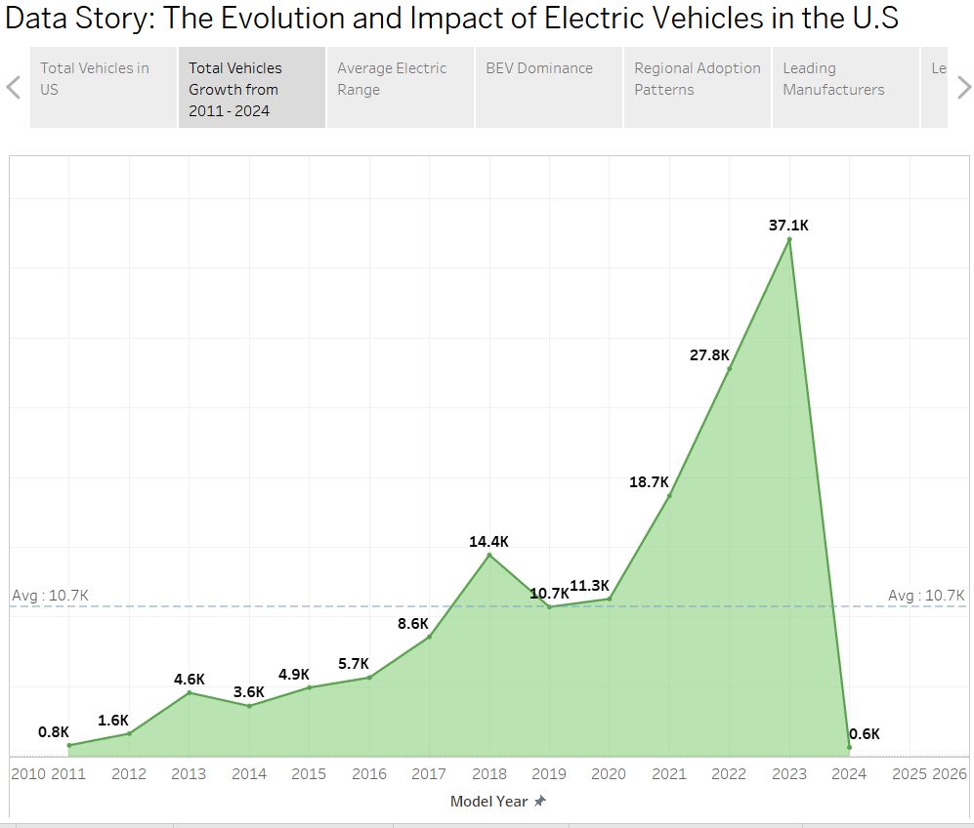
Implementation (Data Story)
Data Story: The Evolution and Impact of Electric Vehicles in the U.S
Data Story 2 - Total Vehicles Growth : The journey of electric vehicles (EVs) in the United States has seen remarkable growth over the years. Starting from a modest base in 2010, the number of EVs has surged, seeing a peak of over 37,000+ in 2023 and an average of 10,700.

Slide 18
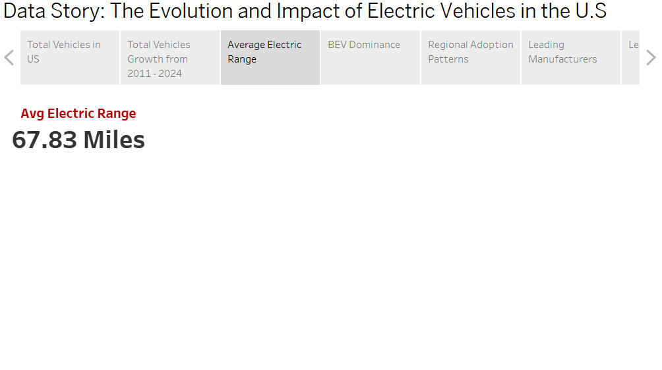
Implementation (Data Story)
Data Story: The Evolution and Impact of Electric Vehicles in the U.S
Data Story 3 - Average Electric Range: Electric vehicles now offer an average range of 67.83 miles, showcasing significant progress in battery technology, which helps address range anxiety and boosts consumer confidence.

Slide 19
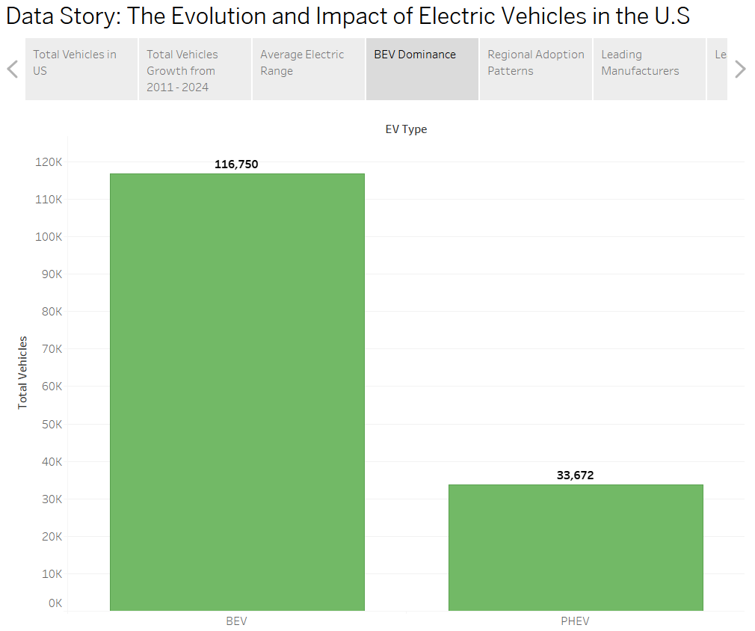
Implementation (Data Story)
Data Story: The Evolution and Impact of Electric Vehicles in the U.S
Data Story 4 - BEV Dominance: Battery Electric Vehicles (BEVs) dominate the EV market with 116,750, comprising 77.6% of the total vehicles. Fully electric models outpace Plug-in Hybrid Electric Vehicles (PHEVs) with 33,672, highlighting consumer preference for zero-emission options, visualized by Bar chart (Total Vehicles vs EV Type)

Slide 20
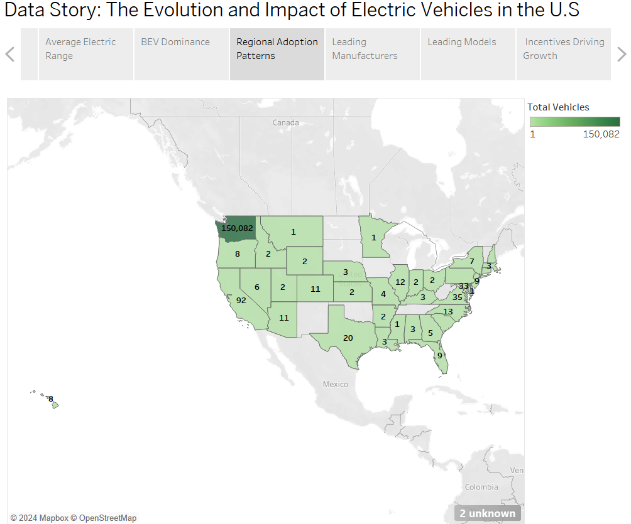
Implementation (Data Story)
Data Story: The Evolution and Impact of Electric Vehicles in the U.S
Data Story 5 - Regional Adoption Patterns California leads the U.S. in EV adoption with 150,082, thanks to its progressive policies and infrastructure. Other states are gradually catching up, presenting opportunities for further growth.

Slide 21
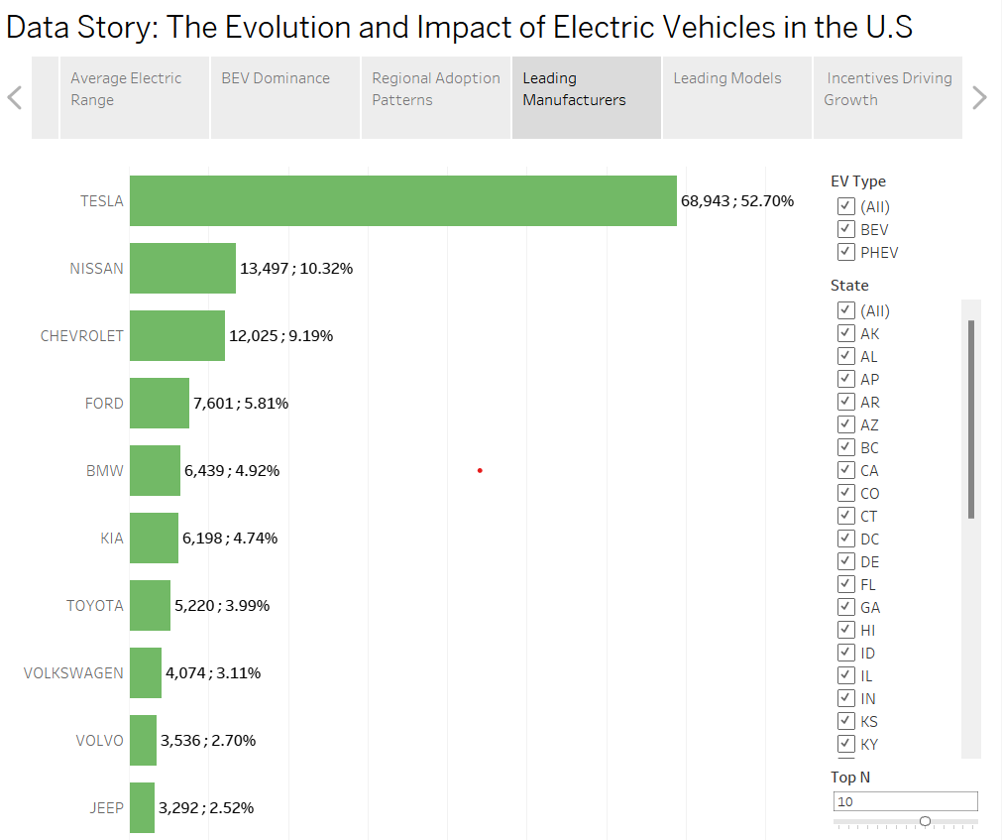
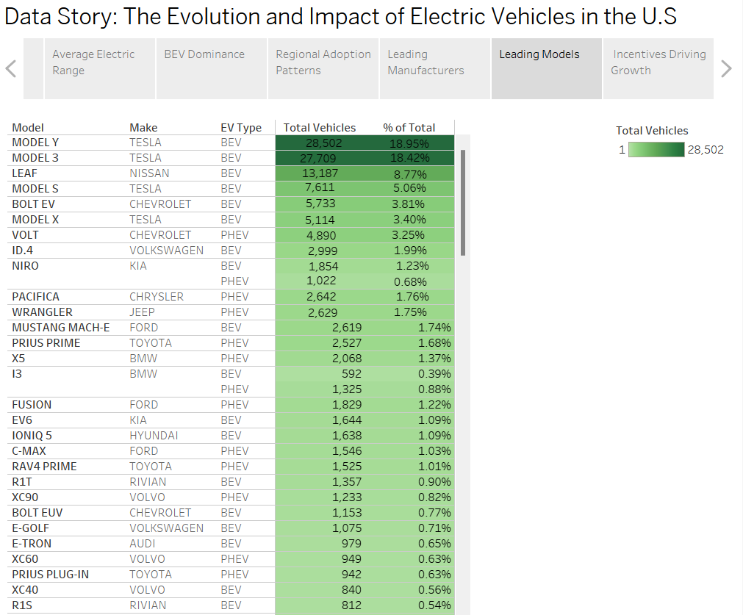
Implementation (Data Story)
Data Story: The Evolution and Impact of Electric Vehicles in the U.S
Data Story 5 & 6 - Leading Manufacturers and Models Tesla reigns as the market leader with over 68,943 vehicles, driven by the popularity of Model Y and Model 3 in EV vehicles. Together, these models account for more than 37% of all EVs

Slide 22
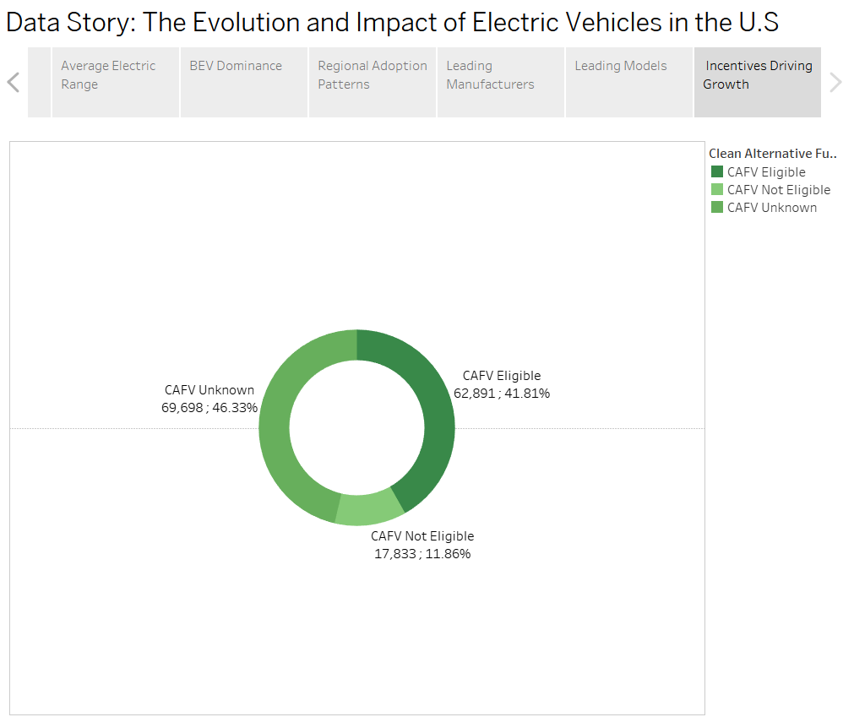
Implementation (Data Story)
Data Story: The Evolution and Impact of Electric Vehicles in the U.S
Data Story 7 - Incentives Driving Growth Clean Alternative Fuel Vehicle (CAFV) incentives play a critical role, with 41.81% of EVs eligible. Expanding incentive programs could accelerate adoption in untapped markets

Slide 23
Justification of the analysis and visualization used
The analysis and visualizations in the workbook are tailored to address the problem statement comprehensively and to provide actionable insights about the electric vehicle (EV) market. Here's the justification for each component:
1. Total Vehicles Analysis (Worksheet 1)
Purpose: To assess the overall size and growth of the EV market, including both Battery Electric Vehicles (BEVs) and Plug-in Hybrid Electric Vehicles (PHEVs).
Justification: By providing a comprehensive count of vehicles, this analysis serves as a baseline for understanding market penetration and adoption trends.
2. Average Electric Range (Worksheet 2)
Purpose: To evaluate technological progress in battery efficiency and its impact on consumer confidence.
Justification: Average electric range directly addresses range anxiety, a critical barrier to EV adoption. Highlighting improvements showcases advancements and builds trust in EV technologies.

Slide 24
Justification of the analysis and visualization used
3. BEV and PHEV Market Share (Worksheets 3 & 4)
Purpose: To analyze the dominance of BEVs and the contribution of PHEVs to the overall market.
Justification: Segmenting the market by vehicle type helps identify consumer preferences and future opportunities for fully electric or hybrid models.
4. Total Vehicles by Model Year (Worksheet 5)
Visualization: Line/Area Chart
Purpose: To illustrate the temporal growth pattern and adoption trends of EVs.
Justification: A time-series visualization is ideal for understanding growth dynamics and projecting future trends, enabling stakeholders to make informed decisions.

Slide 25
Justification of the analysis and visualization used
5. Geographical Distribution (Worksheet 6)
Visualization: Map Chart
Purpose: To show the spread of EV adoption across different states.
Justification: A map provides clear geographical insights, highlighting regions with high adoption rates and potential markets for expansion.
6. Top 10 Manufacturers (Worksheet 7)
Visualization: Bar Chart
Purpose: To identify leading manufacturers and their contributions to the market.
Justification: A bar chart effectively ranks and compares manufacturers, highlighting dominant players and competitive dynamics.

Slide 26
Justification of the analysis and visualization used
7. CAFV Eligibility (Worksheet 8)
Visualization: Pie/Donut Chart
Purpose: To show the proportion of EVs eligible for Clean Alternative Fuel Vehicle (CAFV) incentives.
Justification: Circular charts visually demonstrate the distribution of eligible vehicles, emphasizing the role of incentives in market growth.
8. Top N Models (Worksheet 9)
Visualization: Tree Map
Purpose: To highlight the most popular EV models.
Justification: A tree map is suitable for visualizing hierarchical data, showing the relative popularity of different models in a compact format.

Slide 27
Justification of the analysis and visualization used
9. Data Story Highlights
Purpose: To narrate the evolution of EV adoption, regional trends, technological advancements, and the impact of policies and incentives.
Justification: By summarizing key insights, the data stories make the analysis accessible to a broader audience, from policymakers to consumers.
Overall Justification
The chosen visualizations align with best practices in data visualization, ensuring clarity, relevance, and engagement. They address specific analytical goals:
Temporal Trends: Line/Area charts provide clarity on growth patterns.
Geographic Insights: Map charts pinpoint adoption hotspots.
Market Dynamics: Bar and pie charts highlight key players and policies' impact.
Consumer Preferences: Tree maps offer detailed insights into popular models.
Each visualization is purposefully selected to provide actionable insights, making the analysis comprehensive and impactful for stakeholders.

